Slide 1

Hospice Chaplaincy in the Age of COVID-19
May 7, 2020

Slide 2

Carolyn Richar MDiv., RN, CHPN
Chief Mission Officer
Capital Caring Health

Slide 3
John Tastad, SCC Coordinator, Spiritual Support Services Sharp HospiceCare

Slide 4
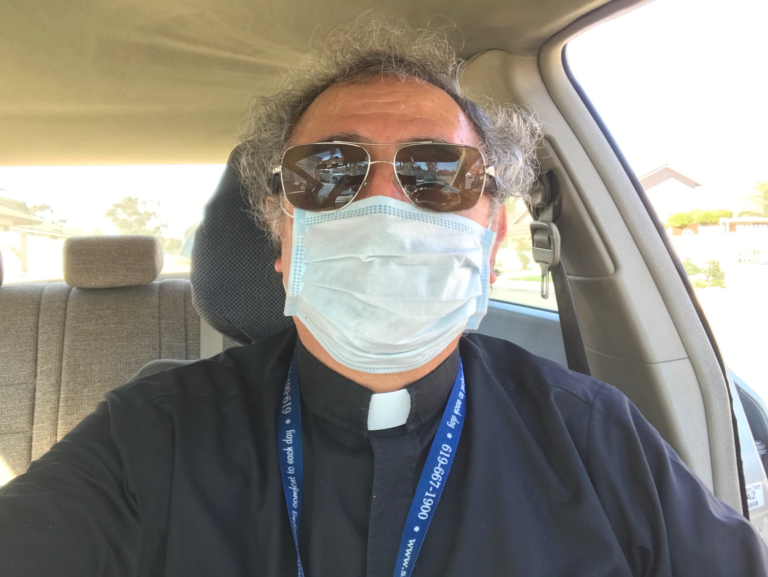
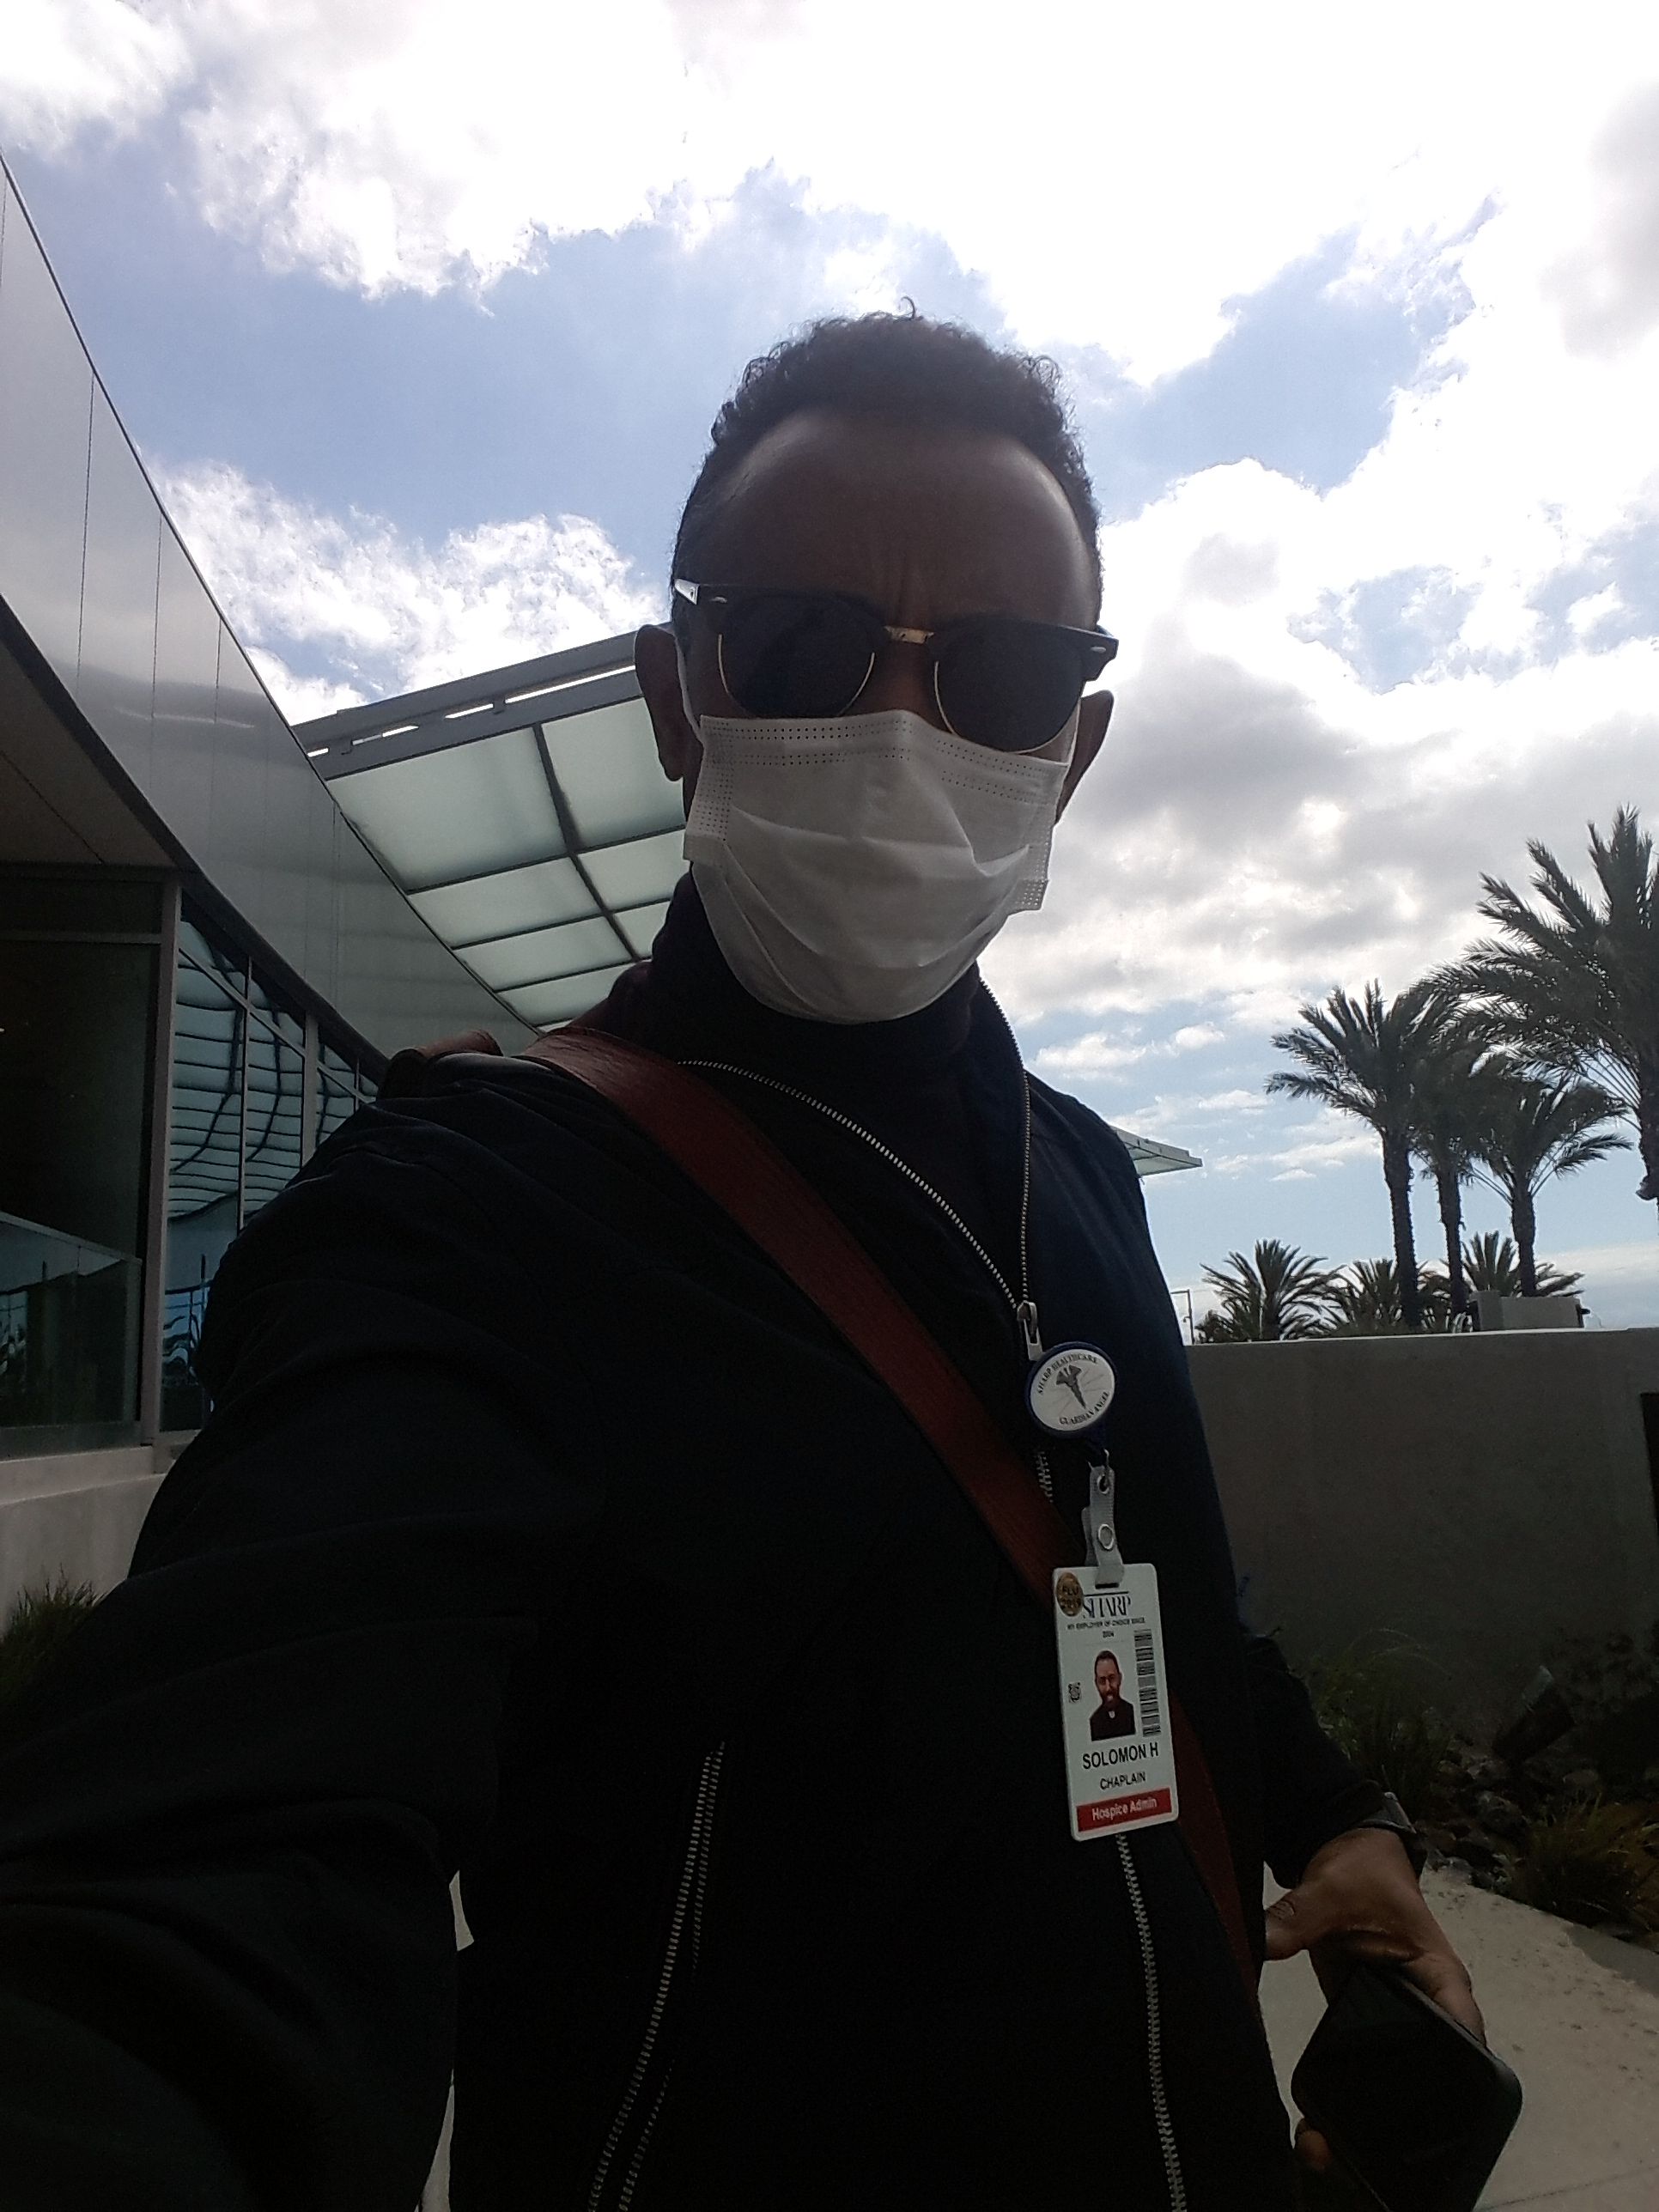
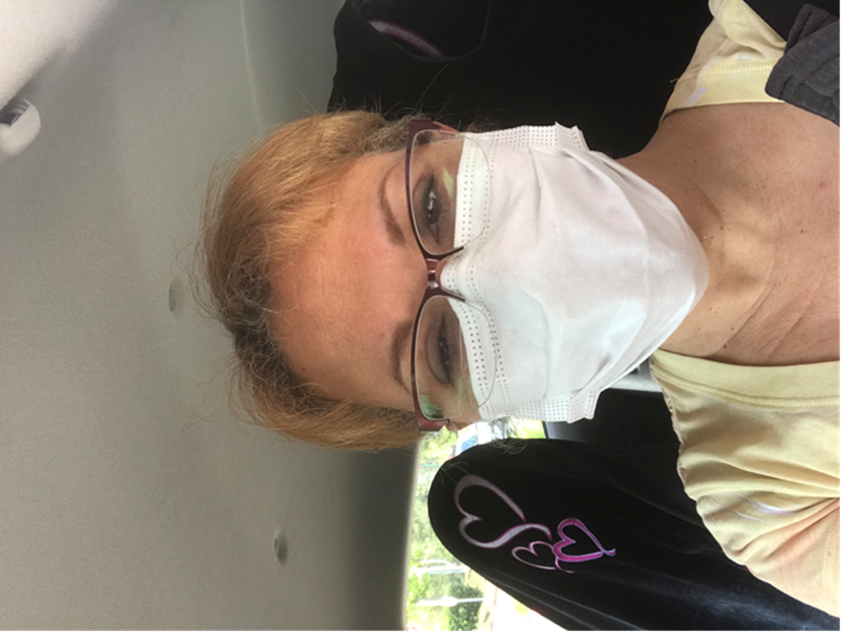
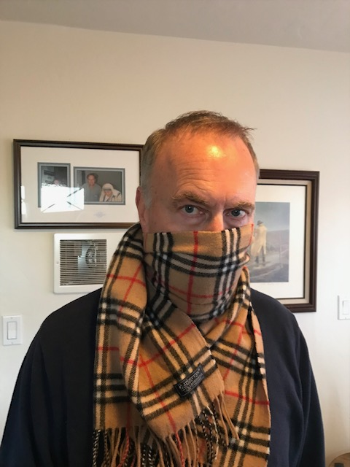
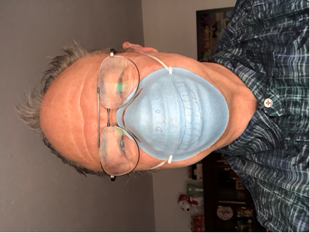
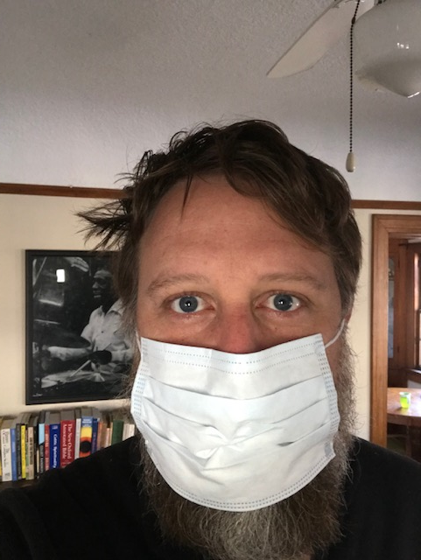
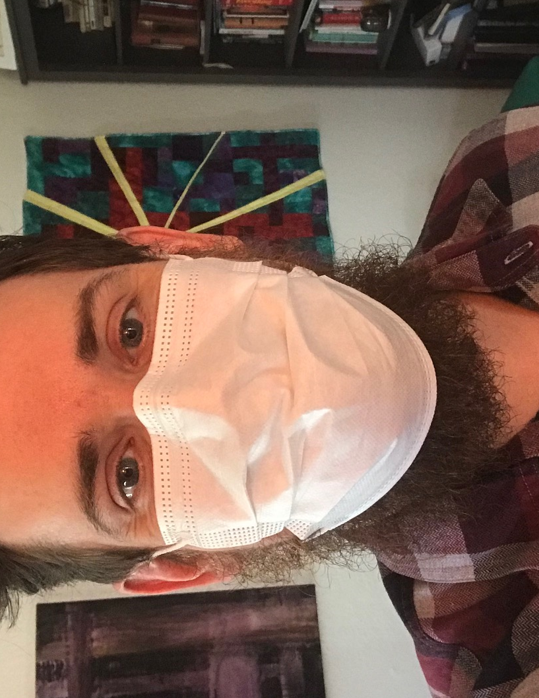
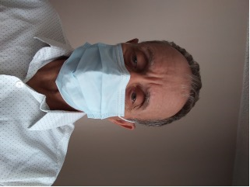
The Spiritual Care Team at Sharp HospiceCare
Daily Support at IDT AM Call-In Huddle
Innovative Visit Formats
Notes:
Charged with “Staff Wellness” at Sharp HospiceCare in San Diego, the SCC team has been actively engaging in M-F huddles with reflections, reassurance, calming/supportive presence.
Flexible staffing with decreased in-person visits.

Slide 5

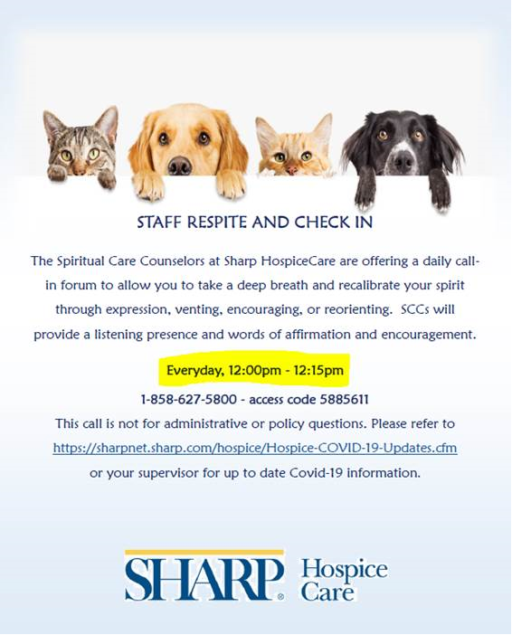
Staff Support
Notes:
Special events for staff support have been engaged in:
Zoom at Noon
Online Hand Blessing and Resilience Webinar
Daily Staff Respite and Check-In calls
Attendance is always optional. Feedback has been extremely positive.
Message sent: “We care about you during this challenging time.”

Slide 6
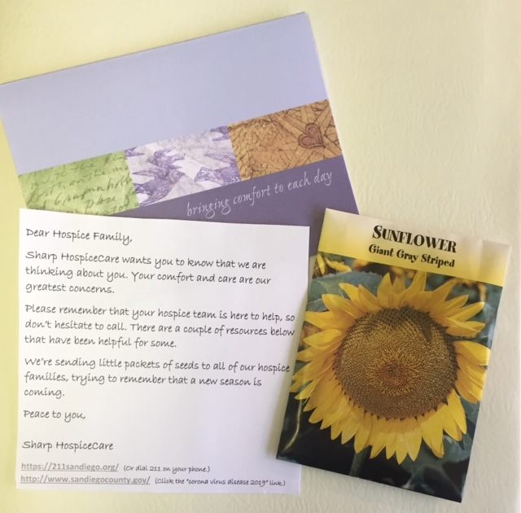
Cards and Seeds to Hospice and Home-Based Palliative Care Patients
Notes:
Safety precautions –
Easy pick up/drop off at office with no building entrance or contact required.
When completing the cards:
Please wash your hands thoroughly and carefully before handling cards and seeds.
Use a wet sponge to moisten the envelop flap.
Feel free to add a brief personal signature or note, and insert the packet of seeds.
Accurately address w/ name and address on front.
Hand written notes to patients and family members, with a package of seeds shared, and an inspirational message on the back side.
A new season is coming.
“We’ve planted our seeds and can’t wait for the new season to arrive” Many heartfelt expressions of thanks.

Slide 7


Hospice chaplaincy in the age of covid-19
MARIE PHILOMÈNE PÉAN, dMin., BCC.

Slide 8
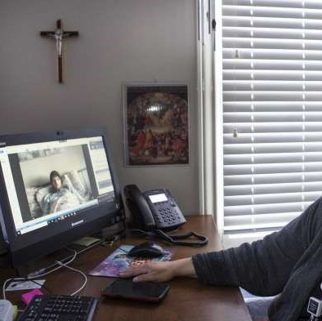
What are the best practices
that Hospice Chaplains bring to the team, patients/families, during
Covid-19 crisis?

Slide 9

A CHAPLAIN’S JOURNEY WITH COVID-19 Reasons to sign up for Hospice
Frequent hospitalizations or trips to the ER
Frequent or reoccurring infections
Reduced desire to eat, leading to significant weight loss and changes in body composition
Rapid decline in health over past six months, even with aggressive medical treatments
Uncontrolled pain, shortness of breath, nausea or vomiting
Decreasing alertness, withdrawal, increased sleeping or mental confusion
Inability to perform tasks of daily living, such as eating, walking, using the bathroom, personal cleaning or getting dressed
Decision to focus on quality of life, instead of aggressive treatments.
Compassus website: https://www.compassus.com/for-caregivers/signs-it-may-be-time-for-hospice

Slide 10

MINISTRY OF PRESENCE
Covid-19 patients dying alone
Failure of our governments
Church leaders and Secular institutions unprepared

Slide 11
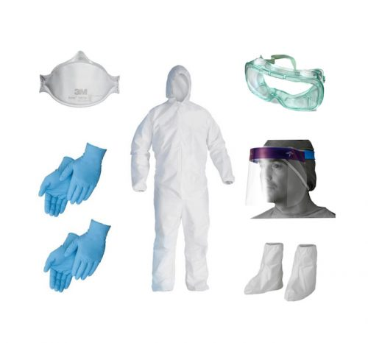
CALL FOR PPE (Personal Protective Equipment)
PPE
TEST FOR CHAPLAINS

Slide 12

Natural Protection
Desire In Her Soul
I wanted To hold Him as an infant, What woman would not find that desire in her soul? Yes, I wanted to hold Him when he was so in need, that he might cling to me with all His strength for protection.
I never thought of the sun as being maternal but is there anything that does not nurse light?
One day I was carrying my wash, one day I was carrying bread, one day I was carrying a small goat, and all of them became my Lord. I collapsed on the ground the first time this happened, the first time the universe suckled me. Teresa of Avila

Slide 13



SMS: OK
EMAIL: OK
ZOOM: OK
FACEBOOK: OK
HEALTH RECOVERY SOLUTION (HRS): OK
PARKING MINISTRY: OK
ADAPTED FORMS OF SPIRITUAL CARE
SKYPE: So So
VOICEMAIL: So So
CHATTING: So So
Web:piayiti.org: Haitian creole spiritual resources

Slide 14
HOSPICE AND BEREAVEMENT
We honor veterans’ program
Calls by Chaplains, Social Worker and Bereavement Coordinator
We remember: Ritual at Interdisciplinary (IDT) meeting
Sympathies card signed by the team
Prayer shawl

Slide 15
LOSS & HOPE
In the act of losing there is something to be found.
In the act of letting go, there is something to be grasped.
In the act of saying “goodbye”, there is a “hello” to be heard.
For I believe living with loss is about beginnings as well as endings.
And grieving is a matter of life more than death.
And growing is a matter of mind and heart and soul more than of body.
And loving is a matter of eternity more than of time.
Finally, I believe in the promising paradoxes of LOSS.
An Affirmation for Those Who Have Lost - James E. Miller

Slide 16

CHAPLAIN’S KIT DURING DISASTER/PANDEMIC
HOPE
Be agents of hope in the process of dying
FAITH
Explore the person’s identity or spirituality
LOVE
Be proud of our profession – Advocate for our patients and for ourselves – Attract new people

Slide 17
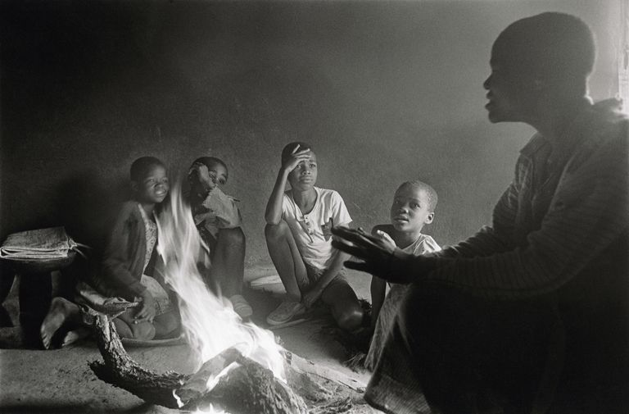
Six Little Stories with Lots of Meaning
(1) Once all the villagers decided to pray for rain. On the day of prayer, all the people gathered, but only one boy came with an umbrella. That is Faith.
(2) When you throw babies in the air, they laugh because they know you will catch them. That is Trust.
(3) Every night we go to bed without any assurance of being alive the next morning, but we still set alarms. That is hope.
(4) We plan big things for tomorrow in spite of zero knowledge of the future. That is Confidence.
(5) We are the world suffering, but still, we get married and have children. That is love.
(6) On an old man’s shirt was written a sentence “I am not 80 years old; I am sweet 16 with 64 years of experience.” That is attitude.
Unknown author.

Slide 18


Faith, hope and love,
Let these endure
among you;
And the greatest
of these is love.
The greatest of
these is love.
David Haas, 1992

Slide 19

Homecare/Hospice Spiritual Care in the midst of a Pandemic…
Dr. Bethany Turner, MA, MC, EdD – May 2020

Slide 20

Three Areas of Support- #Inthistogether
Chaplain Self Care & Resilience
Staff Support
Patient & Family

Slide 21

Chaplain Resilience
Challenges
Solutions
Increase Work Load
Higher levels of Organizational Distress & Increased Mortality
Increased Moral Distress
Work/Life Balance
Remote Work
Self Care- Sleep, Hydration, Exercise, Spiritual Practice
Resilience Training using name, claim, reframe & PTG
Buddy System- Weekly Check-ins & Weekly Team Debriefs
Rituals for Start/End Work- Hand washing, Scrubs, Burden Tree
Weekly Trainings/ Best Practice Sharings

Slide 22

Staff Support- Resilience
Daily Reflections & Teams Meetings started with quotes of inspiration
Rituals for Shift Changes
Midweek Teams Meeting Meditation & Debrief Space
Intentional Outreach to Staff for Check-Ins & Rounding with Managers for anyone they feel needs support… (“easier to apologize for overstepping than to regret not asking.”)
Honoring Truth, Affirming, Reframing
On Call 24/7 for support
Reframing the Role of Heroes…”Every organism’s life is arguably a composition/ equation of intermittent acts of heroism to varying degrees, most often seamlessly blurring into reality.” Olivia Efthimiou
Trauma Informed Care & PTG training…
Advocating for Self Care- 5 daily exhale activities…
Cultivating Gratitude & Living in the Moment- What can I do today?

Slide 23
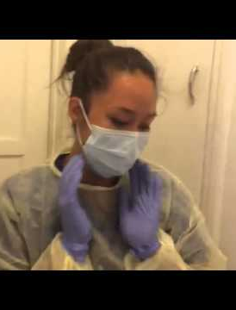
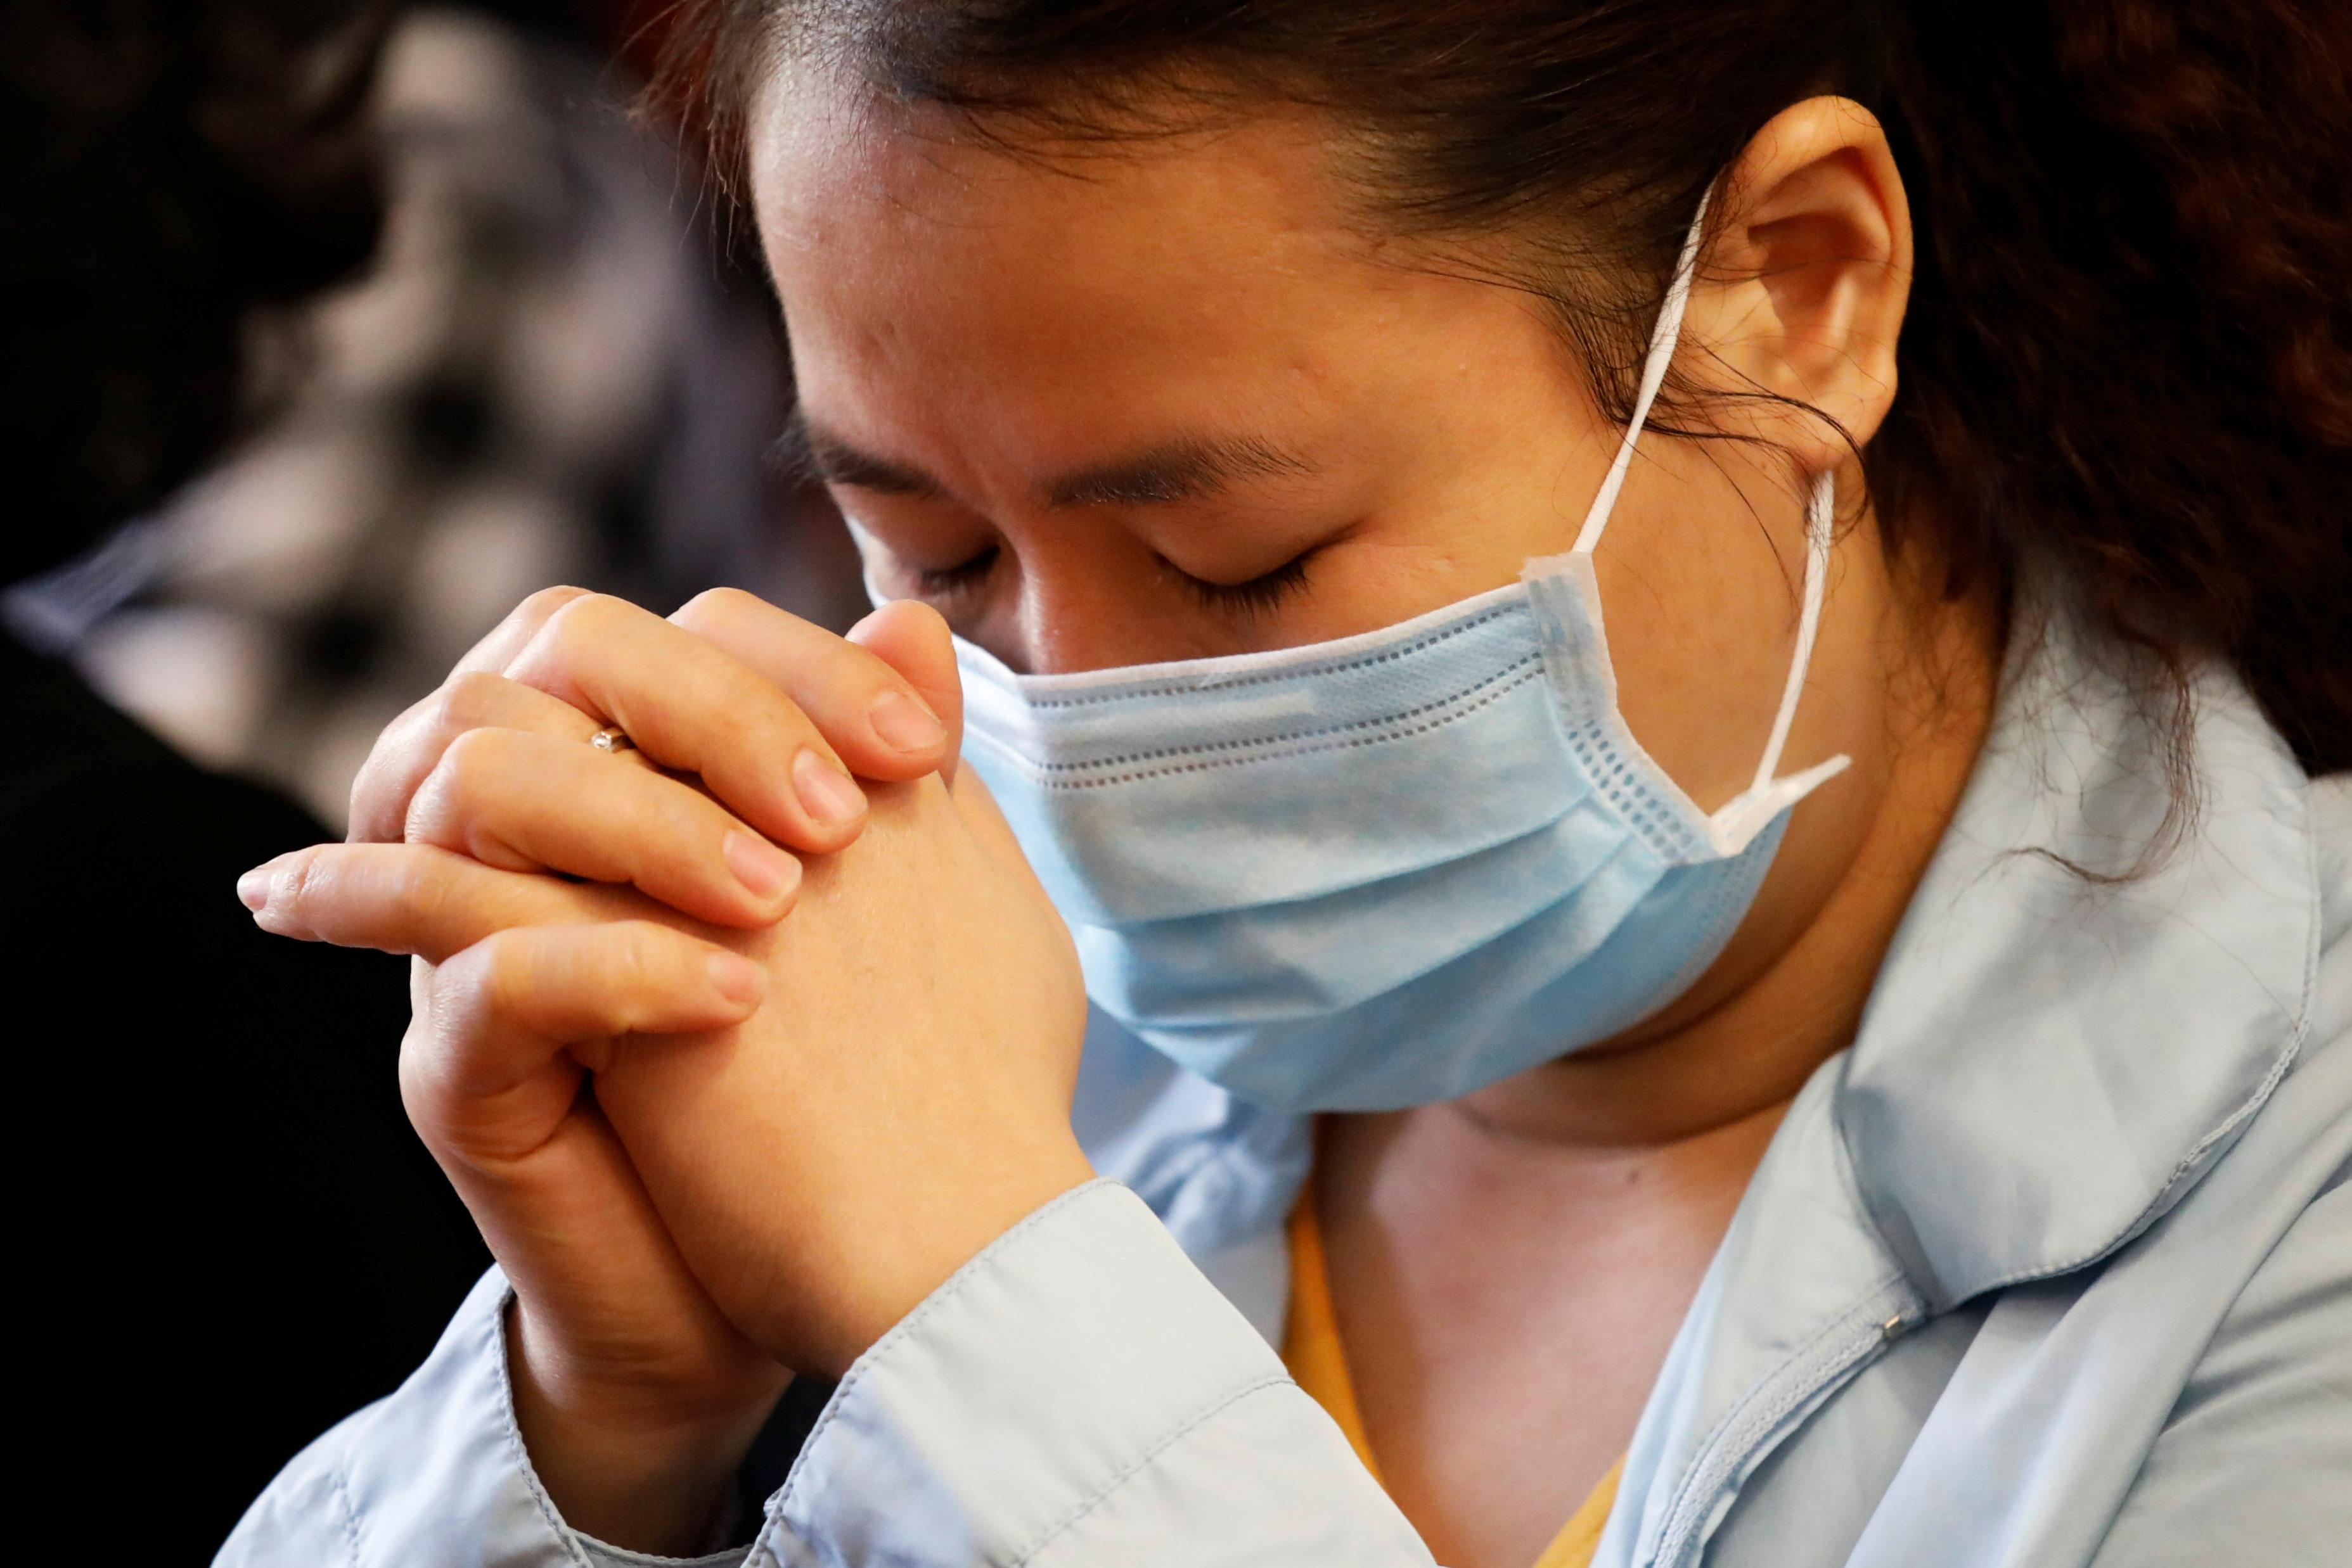
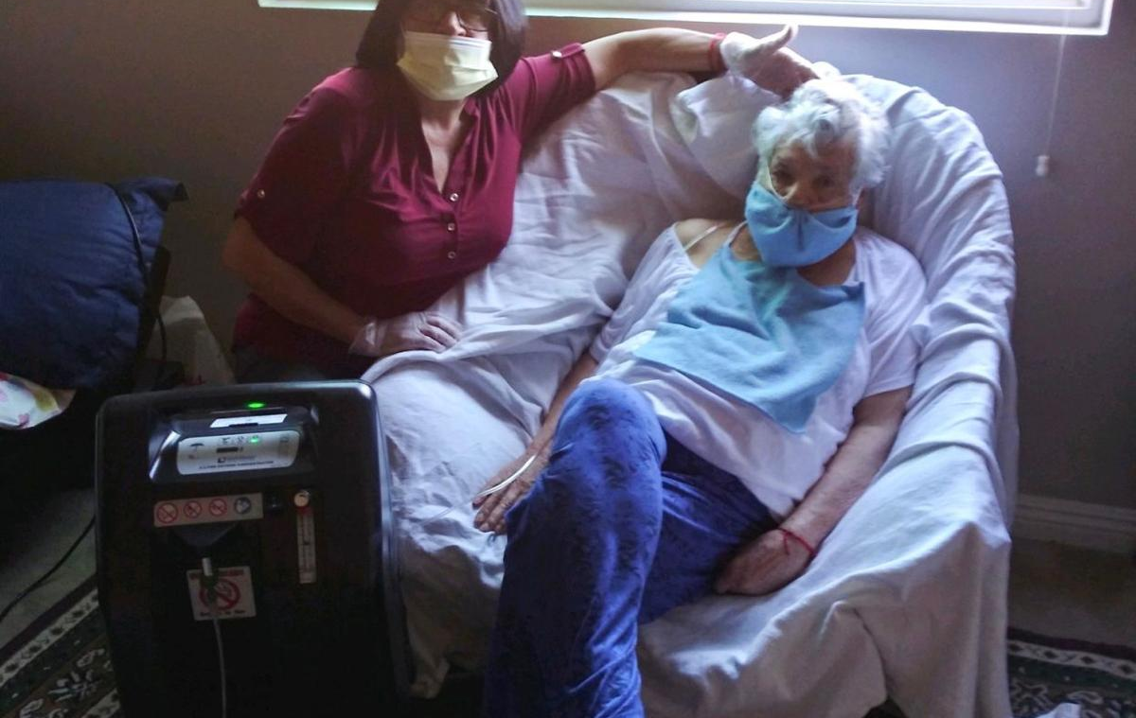

Patient & Family Care Almost overnight, HomeCare & Hospice transitioned to Telehealth due to COVID-19 (Infectious Control & Resources)…
Outcomes- “necessity is the mother of invention”:
Increased # of Patients/ Families receptive to Spiritual Care
Chaplains using Email, Text, Phone & Video platforms to support
Chaplains training pts & families to use platforms- patient response= dignity, gratitude & less isolation
Increased sense of purpose & connectedness- #allinthistogether (Healthcare is Medical Practice- New Innovations)
Increased frequency of visits
Increased list of community resources, especially technology bible studies, groups, church services, mindfulness meditations, Liquid Mind, etc
Remote Rites & Rituals- especially end of life & funerals
Training Staff & Family to help with Rituals
Historical Use of Little Brown Scapular
Elderly Wisdom opportunities- increased life review
Biggest Challenge is Human Touch- Learning to be intentional with the tone of voice & speak from the heart. (Verbally check in about heard tone or tears inviting patient or family to share meaning…)

Slide 24
WHAT ARE YOUR THOUGHTS? IDEAS? QUESTIONS?

Slide 25
Chaplaincyinnovation.org
@chaplainlab
fb.com/chaplainlab

